Slide 1
Leveraging Prompts for Automated Content Generation
Project Associate:
Siddarth J Karbhari siddarthkarbhari@gmail.com
Sphoorthi B Savalgi sphoorthisavalgi01@gmail.com

Slide 2
Index
Introduction
Problem Statement
Objectives
Technologies Used
Results
Conclusion

Slide 3
Introduction
In the era of Artificial Intelligence, content creation is rapidly evolving with the help of Large Language Models (LLMs). This project explores the concept of prompt engineering to automate content generation across various domains such as marketing, technical writing, and software development. By designing structured prompts and leveraging models like GPT-Neo, the project demonstrates how AI can generate coherent, relevant, and human-like text with minimal human intervention. The objective is to enhance productivity while maintaining quality through effective prompt strategies.

Slide 4
Problem Statement
To develop an automatic content generating application using prompt engineering techniques with Large Language Models, enabling faster and more consistent output across various domains.

Slide 5
Objectives
To explore the application of prompt engineering in guiding large language models (LLMs) like GPT-Neo, GPT-3, and GPT-4 for automated content generation.
To design and implement a user-friendly interface that allows users to input structured prompts and generate high-quality, coherent text using AI models.
To develop a content generation pipeline that ensures consistency in tone, style, and structure across various content types such as blogs, articles, reports, and creative writing.

Slide 6
Implementation
The AI-powered code assistant is implemented using a combination of natural language processing (NLP), deep learning, and transformer-based models. The core idea is to allow users to input plain English instructions or existing code, and receive accurate, structured Python code as output—either newly generated, optimized for performance, or refactored for clarity and maintainability.
The system is built around GPT-Neo 1.3B, an open-source transformer model developed by EleutherAI, which is capable of understanding and generating code. Using the Hugging Face Transformers library, the model is loaded into a Python environment and accessed through a text-generation pipeline. This setup allows the system to convert natural language prompts into executable code.

Slide 7
Implementation
The content generation process relies on a text generation pipeline implemented using the Hugging Face Transformers library. The algorithm follows these steps:
User Input: The user provides a prompt specifying the type of content to be generated.
Model Processing: The generate_content() function is invoked, using the GPT-Neo model to generate text based on the given prompt. The model predicts the most probable sequence of words to form a coherent output.
Constraints: The generated content is limited to a maximum of 200 tokens, ensuring that the output remains concise and relevant.
Randomness and Creativity: The function uses the do_sample=True parameter to introduce some degree of randomness, enhancing creativity in the generated content.
Output: The generated text is displayed as the final output, ready for review or further refinement.

Slide 8
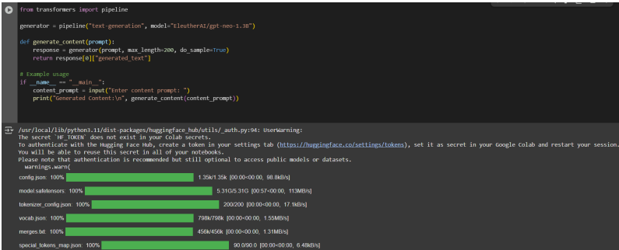
Results

Slide 9
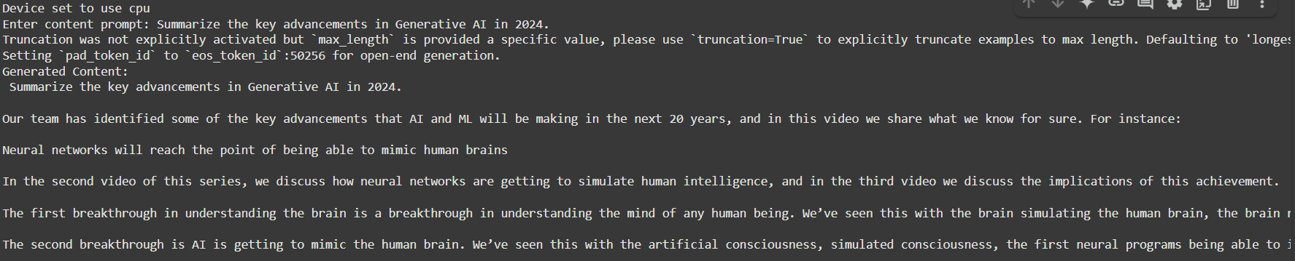
Results
Content generated on the prompt “Summarize the key advancements in Generative AI in 2024”

Slide 10
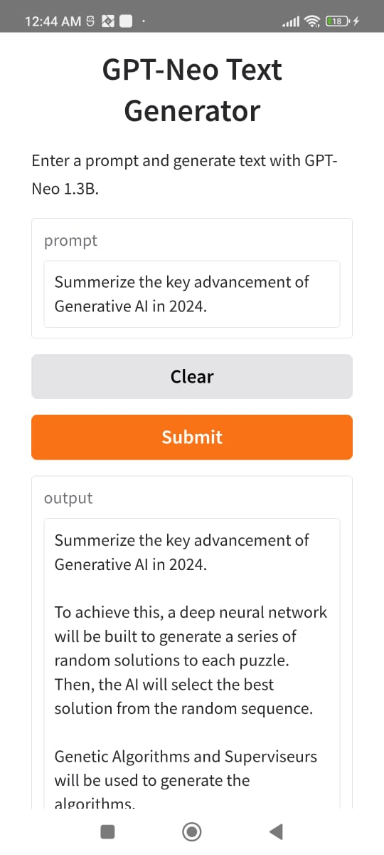
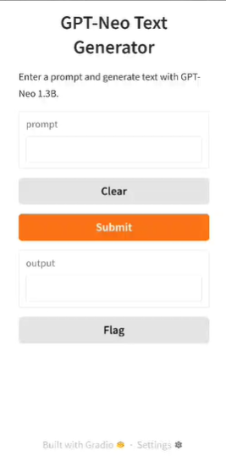
Results
Application Interface
Interface Results

Slide 11
Declaration
The project successfully demonstrated the potential of using GPT-Neo 1.3B for automated content generation. It proved to be an efficient tool for generating high-quality, contextually relevant, and creative text with minimal human intervention. By leveraging structured prompts, businesses and individuals can significantly streamline content creation processes while maintaining quality and consistency. Further optimization could lead to even more tailored and specialized outputs for diverse industries.

Slide 12
Thank You

